Slide 1
AI – DIET MEAL PLAN GENERATOR
Presented by :
RANJITH KUMARAN G (210701209)
SAKTHIVEL SP (210701224)
SAM LAWRANCE V (210701225)
Under the Guidance
Mr.Vijay K B.Tech., M.E.,
Assistant Professor (SG)

Slide 2
ABSTRACT
The AI-Diet Meal Generator offers a personalized solution to the challenge of maintaining a healthy diet by harnessing artificial intelligence. It analyzes user data, including dietary restrictions, health goals, and culinary preferences, to generate tailored meal plans optimized for nutritional content and portion sizes. The system accommodates diverse dietary requirements and promotes culinary diversity by suggesting a range of recipes from various cuisines. Through its intuitive interface, users can explore recipe alternatives, adjust serving sizes, and access nutritional information. By emphasizing individualization and adaptability, the AI-Diet Meal Generator empowers users to cultivate sustainable dietary habits, leading to improved health outcomes and overall well-being. This innovative approach to meal planning represents a promising step towards promoting healthier lifestyles in an increasingly digitalized world.

Slide 3
PROBLEM STATEMENT
The AI Diet Meal Plan Generator aims to help users create personalized meal plans that cater to their dietary preferences, nutritional requirements, and health goals. Users input their age, gender, weight, height, activity level, dietary preferences, food allergies, and specific health objectives such as weight loss or muscle gain. The AI analyzes this data to calculate daily caloric needs and ensure a balanced intake of macronutrients and micronutrients. It then generates a weekly meal plan with varied recipes for breakfast, lunch, dinner, and snacks, adapting to dietary restrictions and medical conditions, thus making healthy eating easy and tailored to individual needs.

Slide 4
Literature Review
Ref No. | Year | Title | Author’s Name | Journal | Description
1. | 2005 | artificial intelligence method for weekly dietary menu planning | Gaál, B., Vassányi, I., & Kozmann, G. | IEEE, DOI:10.1109/ICCUBEA.2018.8697827 | The literature survey for "A novel artificial intelligence method for weekly dietary menu planning" likely encompasses an examination of traditional dietary planning methods and their limitations, along with an exploration of previous research utilizing artificial intelligence techniques, computational optimization algorithms, and nutritional guidelines.
2. | 2022 | PROTEIN AI advisor | Stefanidis, K., Tsatsou, D., Konstantinidis, D., Gymnopoulos, L., Daras, P., Wilson-Barnes | Computers and Electronics in Agriculture ,ISSN : 0168-1699 (Elsevier) | The literature survey for "PROTEIN AI advisor: a knowledge-based recommendation framework using expert-validated meals for healthy diets" likely explores existing research on dietary recommendation systems, artificial intelligence applications in nutrition, and knowledge-based frameworks for healthy eating. .
3. | 2015 | Towards diet management with automatic reasoning and persuasive natural language generation | Anselma, L., & Mazzei, A. | EPIA 2015, Coimbra, Portugal, September 8-11, 2015. Proceedings 17 (pp. 79-90). Springer International Publishing. | It's a difﬁcult task to predict crop yield due to stochastic rain fall pattern and also variation in temperature. So we can apply different data mining techniques for crop yield predication and can produce an efﬁcient algorithm for crop classiﬁcation for better.

Slide 5
Literature Review
Ref No. | Year | Title | Author’s Name | Journal | Description
4. | 2007 | Application of artificial intelligence for weekly dietary menu planning | Gaál, B., Vassányi, I., & Kozmann, G. | Advanced Computational Intelligence Paradigms in Healthcare-2, 27-48. | "Application of artificial intelligence for weekly dietary menu planning" likely delves into existing research on artificial intelligence applications in dietary planning and optimization. This review would encompass studies exploring various AI techniques.
5. | 2009 | Automatic meal planning using artificial intelligence algorithms in computer aided diabetes therapy | Bulka, J., Izworski, A., Koleszynska, J., Lis, J., & Wochlik, I | International Conference on Autonomous Robots and Agents (pp. 393-397). IEEE. | The literature survey for "Automatic meal planning using artificial intelligence algorithms in computer-aided diabetes therapy" likely delves into existing research on artificial intelligence applications in diabetes management and dietary planning
6. | 2020 | Application of Artificial Intelligence for weekly meal planning for children | Kalra, S., Arora, G., & Aggarwal, R. | 2020 International Conference for Emerging Technology (INCET) | This paper predicts the yield of almost all kinds of crops in India. This script makes novel by usage of simple parameters like state, district, season, area and the user can predict the yield of the crop in which year he or she wants to.

Slide 6
Literature Review
Ref No. | Year | Title | Author’s Name | Journal | Description
7. | 2023 | Smart Cuisine: Generative recipe & ChatGPT powered nutrition assistance for sustainable cooking | Kansaksiri, P., Panomkhet, P., & Tantisuwichwong, N. | Procedia Computer Science, 225, 2028-2036. | The literature survey for "Smart Cuisine: Generative recipe & ChatGPT powered nutrition assistance for sustainable cooking" likely explores existing research on computational techniques in recipe generation, natural language processing algorithms for nutrition assistance
8. | 2020 | An artificial intelligence approach to nutritional meal planning for cancer patients | Fox, R., & Bui, Y | Proceedings of the 4th Computer Science On-line Conference 2015 (CSOC2015), Vol 1) | The literature survey for "An artificial intelligence approach to nutritional meal planning for cancer patients" likely investigates existing research on artificial intelligence applications in healthcare, dietary planning, and oncology
9. | 2023 | A nutrient recommendation system for soil fertilization based on Evolutionary Computation. | Fitness Application Generating Recipes Using Artificial Intelligence | Kilby, 100, 7th. | The literature survey for "Fitness Application Generating Recipes Using Artificial Intelligence" likely delves into existing research on artificial intelligence applications in fitness, nutrition, and recipe generation

Slide 7
Literature Review
Ref No. | Year | Title | Author’s Name | Journal | Description
10. | 2024 | The Potential of Generative AI in Personalized Nutrition | OEWEL, B., GULUZADE, L., ZHU, J., & HUANG, Y | Journal of Agriculture and Food Research | The literature survey for "The Potential of Generative AI in Personalized Nutrition" likely delves into existing research on artificial intelligence applications in personalized nutrition and dietary planningEnhanced efficiency fertilizers cannot compensate for other stresses caused by compaction.

Slide 8
PROPOSED SYSTEM
The proposed AI Diet Meal Plan Generator will provide users with personalized meal plans based on their individual profiles, dietary preferences, and health goals. Users will input personal information, dietary preferences, allergies, and health objectives through an intuitive interface. The AI will analyze this data to calculate daily caloric needs and ensure balanced nutrient intake. It will then generate varied and balanced weekly meal plans, adapting to dietary restrictions and health goals. The system will feature secure data storage, a comprehensive recipe database, integration with health tracking apps, and automated reminders for meal prep and shopping. Continuous user feedback will refine and personalize meal plans, making healthy eating easy and tailored to individual needs.

Slide 9
METHODOLOGY
The methodology for developing the AI-Diet Meal Generator will involve a systematic and iterative process, blending elements of agile software development with user-centered design principles. Initially, requirements will be gathered through stakeholder engagement, including nutritionists, dieticians, and potential users, to define project objectives and identify key features. Subsequently, design and prototyping phases will focus on creating intuitive user interfaces, incorporating feedback to ensure usability and alignment with user needs. Development will encompass backend algorithm implementation for data analysis and personalized recommendation generation, alongside frontend development for responsive and accessible user interfaces. Testing and validation cycles will be iterative, with ongoing user feedback informing refinements to functionality and design. Deployment will occur in controlled environments, followed by continuous iteration based on user insights and technical considerations. Evaluation will assess the platform's impact on dietary habits and health outcomes, guiding optimization efforts to enhance effectiveness and user satisfaction. Throughout, documentation and knowledge sharing will facilitate transparency and contribute to the wider community's understanding of the project's methodology and outcomes.

Slide 10
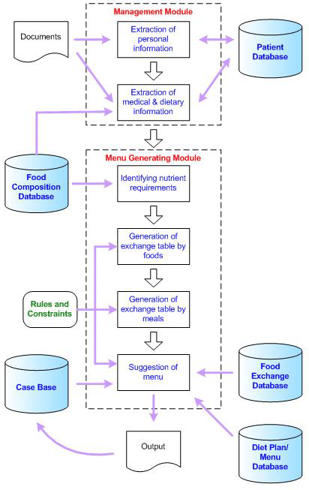
IMPLEMENTATION MODEL
Flowchart :

Slide 11
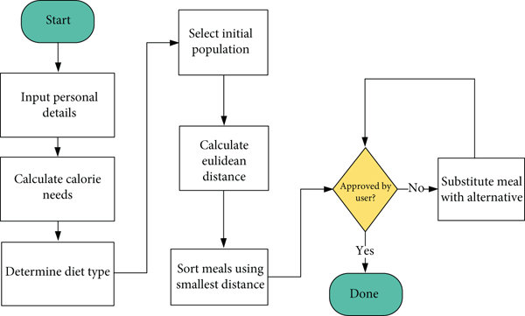
IMPLEMENTATION MODEL
The AI Diet Meal Plan Generator uses user inputs to analyze dietary needs and preferences, generating personalized weekly meal plans. It features secure data storage, a comprehensive recipe database, and integration with health apps. Automated reminders and continuous feedback refine plans, ensuring balanced nutrition and adherence to health goals.

Slide 12
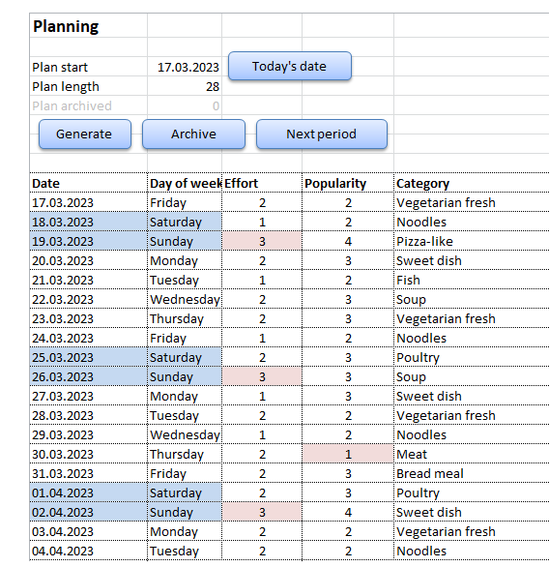
DATA PREPARATION
Actual Dataset :
User data, dietary preferences, and health goals are collected and securely stored. Nutritional data for foods and recipes is compiled, ensuring accurate analysis for personalized meal plan generation.
Customized Dataset

Slide 13
Data Description
Input Features :
Age, gender, weight, height, and activity level.Temperature : temperature in degree Celsius
Vegan, vegetarian, pescatarian, gluten-free, etc.
Weight loss, muscle gain, maintenance, and managing specific conditions like diabetes.
Output Features :
Weekly meal plans tailored to individual dietary needs and preferences.Label
Detailed breakdown of daily caloric intake and macronutrient
Comprehensive list of ingredients needed

Slide 14
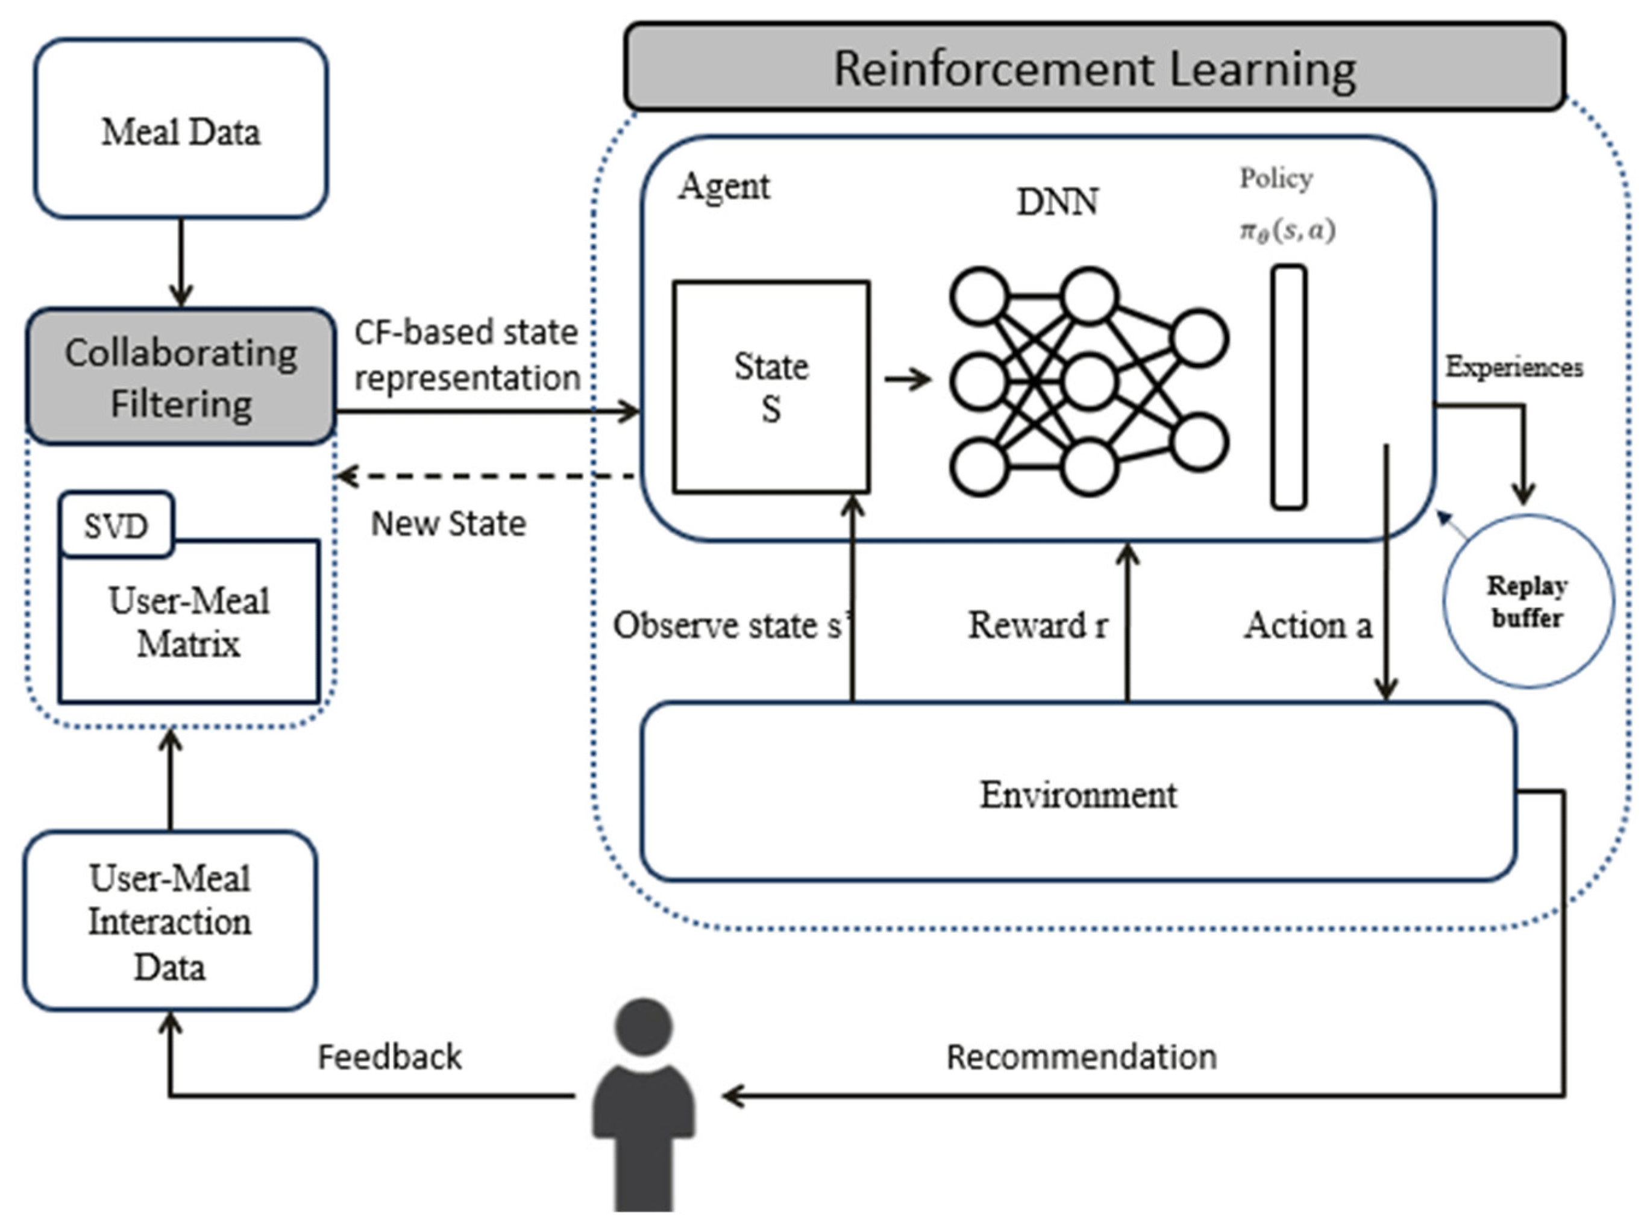
Implementation Algorithm
Random Forest Regression :
Reinforcement learning optimizes meal plans by receiving user feedback on generated plans. The AI adapts and improves its recommendations through rewards for successful meals and adjustments for disliked options. This continuous learning process ensures increasingly personalized and effective meal plans aligned with users' evolving dietary preferences and health goals..

Slide 15
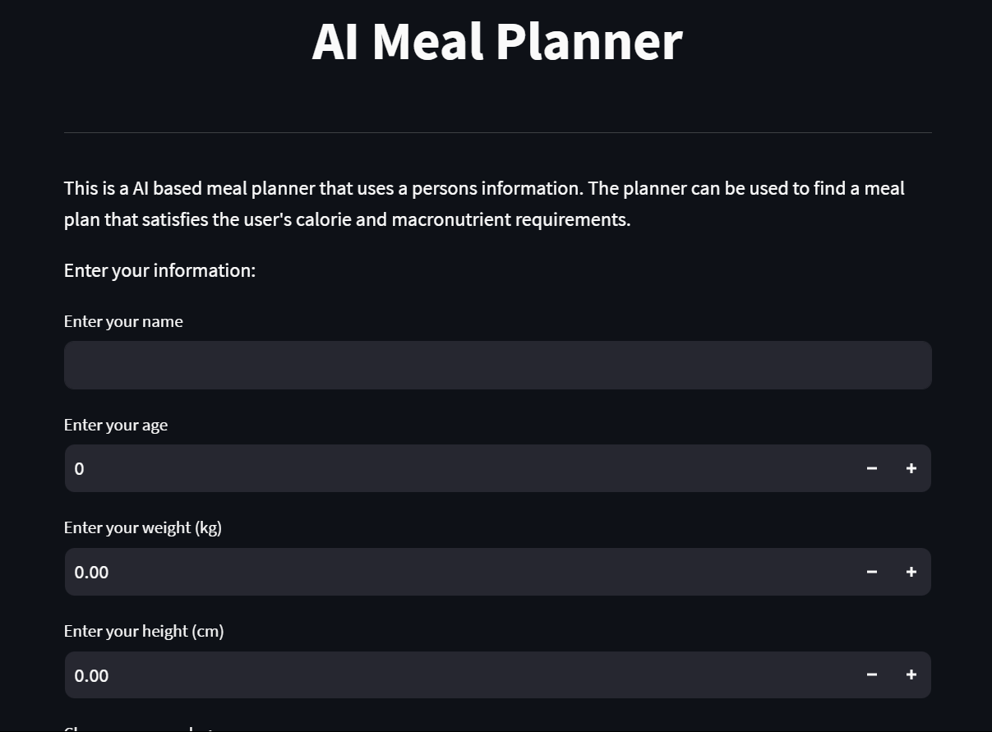
Results
Homepage of meal planner

Slide 16
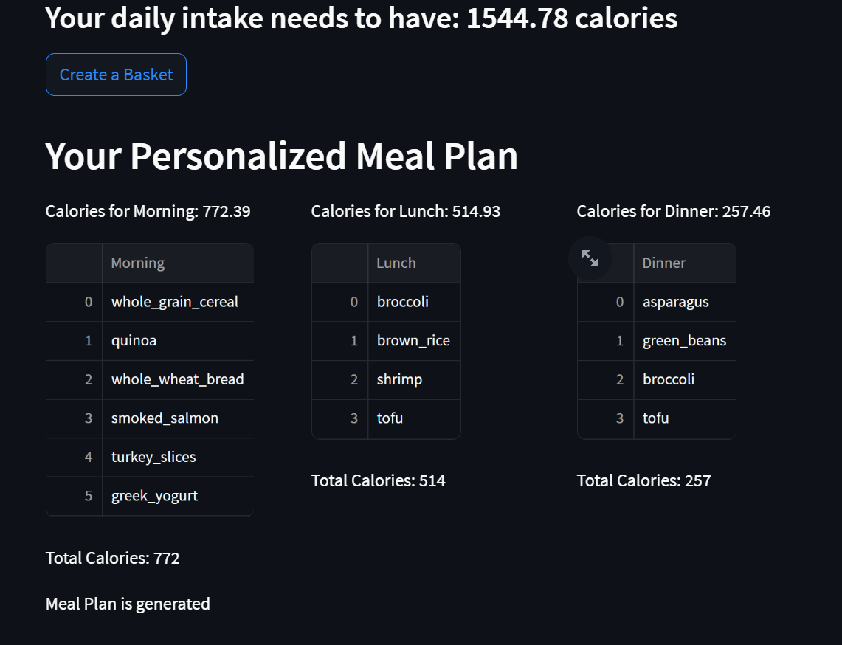

Results
Input Form
Details filled using the drop-down menu

Slide 17
Future Scope
In future iterations, the AI-Diet Meal Generator could incorporate additional features such as real-time nutritional tracking, meal planning automation, and integration with wearable devices or health monitoring apps to provide users with deeper insights into their dietary habits and overall health. Furthermore, leveraging advancements in natural language processing and user interaction technologies could enable more seamless and intuitive interactions, enhancing the user experience. Additionally, expanding the platform's capabilities to include personalized grocery shopping recommendations, meal preparation tips, and community-driven recipe sharing could further enrich the user experience and foster a supportive ecosystem for healthy living. Overall, these enhancements aim to continuously improve the effectiveness, usability, and impact of the AI-Diet Meal Generator in promoting healthier lifestyles and empowering individuals to make informed dietary choice.

Slide 18
Conclusion
In conclusion, the AI-Diet Meal Generator represents a pioneering solution in the realm of dietary planning, harnessing the power of artificial intelligence to revolutionize the way individuals approach meal selection and consumption. By providing personalized meal recommendations tailored to individual preferences and nutritional needs, the platform empowers users to make informed dietary choices that align with their health objectives and lifestyle constraints. Through its intuitive interface, diverse recipe options, and ongoing feedback mechanisms, the AI-Diet Meal Generator facilitates the cultivation of sustainable dietary habits, ultimately promoting improved health outcomes and enhancing overall well-being in users' lives.

Slide 19
References
Anselma, L., & Mazzei, A. (2015). TowarStefanidis, K., Tsatsou, D., Konstantinidis, D., Gymnopoulos, L., Daras, P., Wilson-Barnes, S., ... & Dimitropoulos, K. (2022). PROTEIN AI advisor: a knowledge-based recommendation framework using expert-validated meals for healthy diets. Nutrients, 14(20), 4435
ds diet management with automatic reasoning and persuasive natural language generation. In Progress in Artificial Intelligence: 17th Portuguese Conference on Artificial Intelligence, EPIA 2015, Coimbra, Portugal, September 8-11, 2015. Proceedings 17 (pp. 79-90). Springer International Publishing.
Gaál, B., Vassányi, I., & Kozmann, G. (2007). Application of artificial intelligence for weekly dietary menu planning. Advanced Computational Intelligence Paradigms in Healthcare-2, 27-48.
Bulka, J., Izworski, A., Koleszynska, J., Lis, J., & Wochlik, I. (2009, February). Automatic meal planning using artificial intelligence algorithms in computer aided diabetes therapy. In 2009 4th International Conference on Autonomous Robots and Agents (pp. 393-397). IEEE.
Kalra, S., Arora, G., & Aggarwal, R. Application of Artificial Intelligence for weekly meal planning for children. IIT Delhi.
Kansaksiri, P., Panomkhet, P., & Tantisuwichwong, N. (2023). Smart Cuisine: Generative recipe & ChatGPT powered nutrition assistance for sustainable cooking. Procedia Computer Science, 225, 2028-2036.
Fox, R., & Bui, Y. (2015). An artificial intelligence approach to nutritional meal planning for cancer patients. In Artificial Intelligence Perspectives and Applications: Proceedings of the 4th Computer Science On-line Conference 2015 (CSOC2015), Vol 1: Artificial Intelligence Perspectives and Applications (pp. 215-224). Springer International Publishing.
Pradhan, S., Sasidharan, S., & Verma, V. (2023). Fitness Application Generating Recipes Using Artificial Intelligence. Kilby, 100, 7th.
OEWEL, B., GULUZADE, L., ZHU, J., & HUANG, Y. (2024). The Potential of Generative AI in Personalized Nutrition.
Gaál, B., Vassányi, I., & Kozmann, G. (2005). A novel artificial intelligence method for weekly dietary menu planning. Methods of Information in Medicine, 44(05), 655-664.

Slide 20
THANK YOU

